Slide 1
FUZZY LOGIC ASSIGNMENT
BY
Rashmi lathi – 2015b4a70619p
Vaishnavi bhargava- 2015b4a70777p
Deepika poonia- 2015b4ts0968p

Slide 2
APPLICATIONS IN COMPUTER ENGINEERING
Fuzzy logic is applied in the design of systems, to make use of human knowledge and experience.
STEP 1: Build a fuzzy model from problem domain.
STEP 2: Integration of solution in production environment.

Slide 3
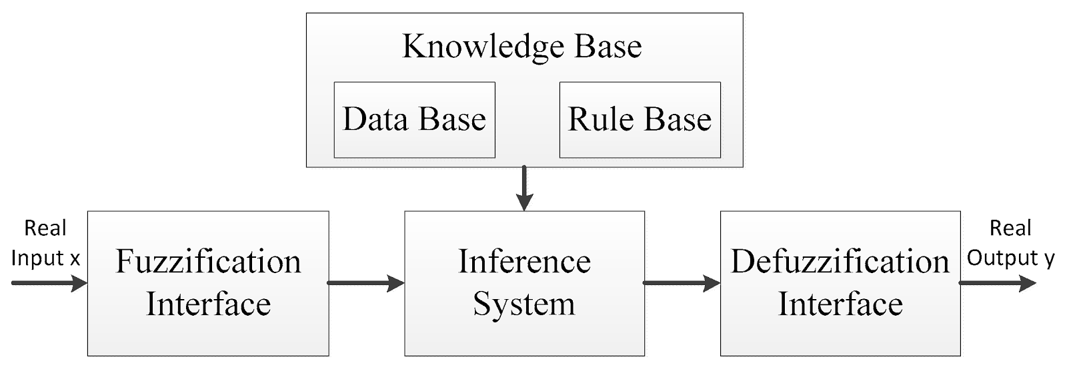
FUZZY CONTROL SYSTEM

Slide 4
GRADED APPROACH
Implementation of Fuzzy Logic in real life problems allows for a partially ordered scale of truth values, including false and true.
Classical logic - {0, 1}. Fuzzy logic – [0,1]

Slide 5
DATA MINING
Data mining- Process of discovering patterns in data.
The purpose is to find homogeneous categories for recognition of class data.
Using fuzzy sets brings flexibility.
The fuzzy rules simplify to natural language.

Slide 6
INFORMATION RETRIEVAL
Information Retrieval – process of organizing data to answer user’s query.
Fuzzy sets enable the user to express expectations in natural language.
Approximate matching between the user’s queries and existing elements in the database

Slide 7
CRYPTOGRAPHY
Cryptography is used for encryption in data communication.
Currently used encryption algorithms only concern about security.
Fuzzy logic algorithm provides either low processing or high security by using variable keys.
Fuzzification changes depending on the key size and the number of mapping

Slide 8
COMPUTER SECURITY
Computer Security concerns the protection of information from misuse.
Fuzzy Logic provides good security analysis by taking advantage of an operator’s experience.
Fuzzy Logic increases the speed of response of the system and thereby its security.
Fuzzy logic can be used to predefine attacks and to store them.

Slide 9
FUZZY LOGIC IN INTRUSION DETECTION
Combine inputs taken from different sources.
They can cope with intrusions where some encroachments cannot be clearly determined.
Fuzzy systems have the ability to recognize the level of the attack because it deal with membership grade functions.

Slide 10
IMAGE PROCESSING
Image processing is a method to convert an image into digital form and perform some operations.
Fuzzy logic is used to incorporate uncertainty.
Fuzzy image processing consists of Image fuzzification, Modification of membership values, Image defuzzification.
Appropriate fuzzy techniques using inference system modify the membership values.

Slide 11
IMAGE EDGE DETECTION
Segmentation- process that subdivides an image into uniformly homogeneous regions.
Traditional algorithms convolute the input image which lead to considerable loss in edge detection.
The fuzzy logic algorithm uses membership functions to define the degree to which a pixel belongs to an edge or a uniform region.

Slide 12

IMPLEMENTATION OF EDGE DETECTION
INTIAL IMAGE

Slide 13
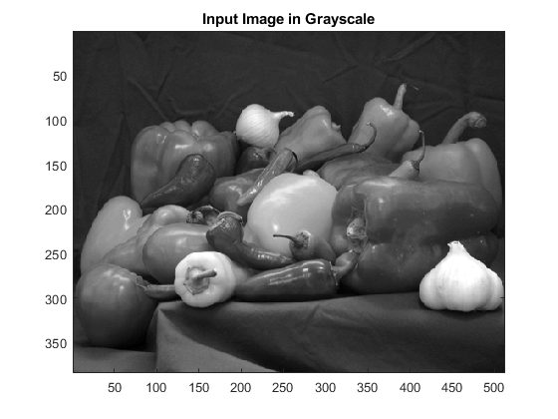
STEPS FOR EDGE DETECTION
Step 1: Import RGB Image and Convert to Grayscale
Step 2: Convert Image to Double-Precision Data and scale
to [0,1]

Slide 14
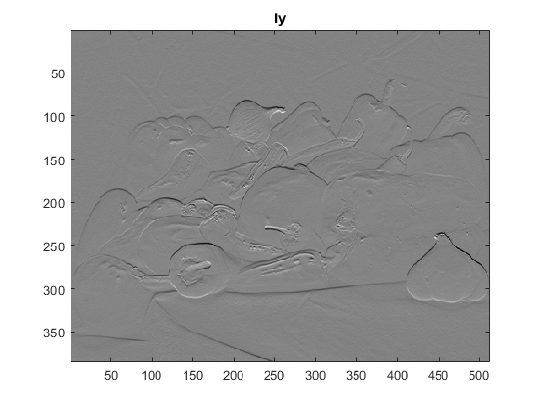
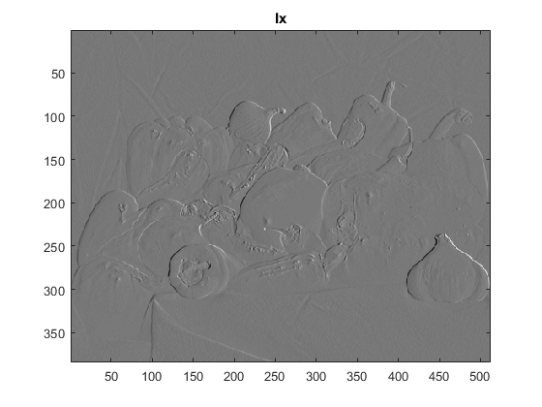
STEPS FOR EDGE DETECTION
Step 3: Obtain Image Gradient to locate breaks in uniform regions.

Slide 15
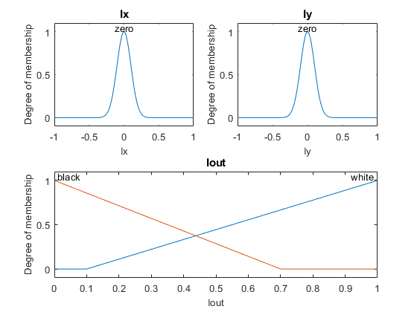
STEPS FOR EDGE DETECTION
Step 4: Define Fuzzy Inference System (FIS) for Edge Detection

Slide 16
STEPS FOR EDGE DETECTION
Step 5: Specify FIS Rules
r1 = 'If Ix is zero and Iy is zero then Iout is white'; r2 = 'If Ix is not zero or Iy is not zero then Iout is black';
Step 6: Evaluate FIS

Slide 17
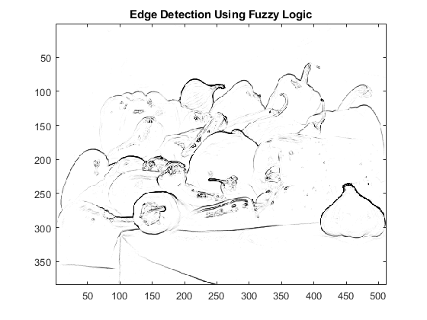
STEPS FOR EDGE DETECTION
Step 7: Plot Results

Slide 18
FUZZIFICATION
Process of changing a real scalar value into a fuzzy value.
Fuzzy membership functions represent likenesses of objects to vague properties.
Fuzzification changes variables into natural language.

Slide 19
FUZZY LINGUISTIC VARIABLE

Slide 20
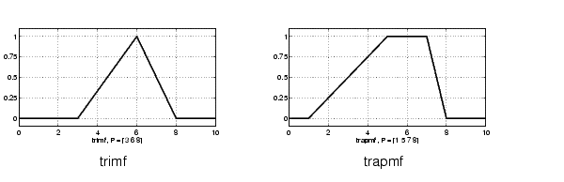
TYPES OF MEMBERSHIP FUNCTIONS
Triangular Membership Function
Function name: trimf

Slide 21
TYPES OF MEMBERSHIP FUNCTIONS
Trapezoidal Membership Function
Function name: trapmf

Slide 22
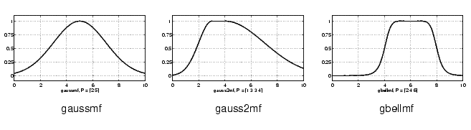
TYPES OF MEMBERSHIP FUNCTIONS
Gaussian And Generalized Bell Function

Slide 23
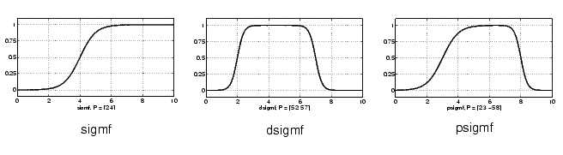
TYPES OF MEMBERSHIP FUNCTIONS
Sigmoidal Function

Slide 24
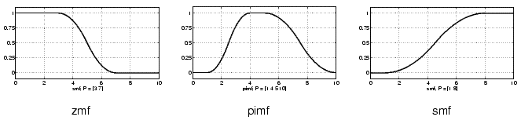
TYPES OF MEMBERSHIP FUNCTIONS
Polynomial Function

Slide 25
DEFUZZIFICATION
It is the process of producing a quantifiable result in Crisp logic.
It’s maps a fuzzy set to a crisp set.
It is inverse of fuzzification.

Slide 26
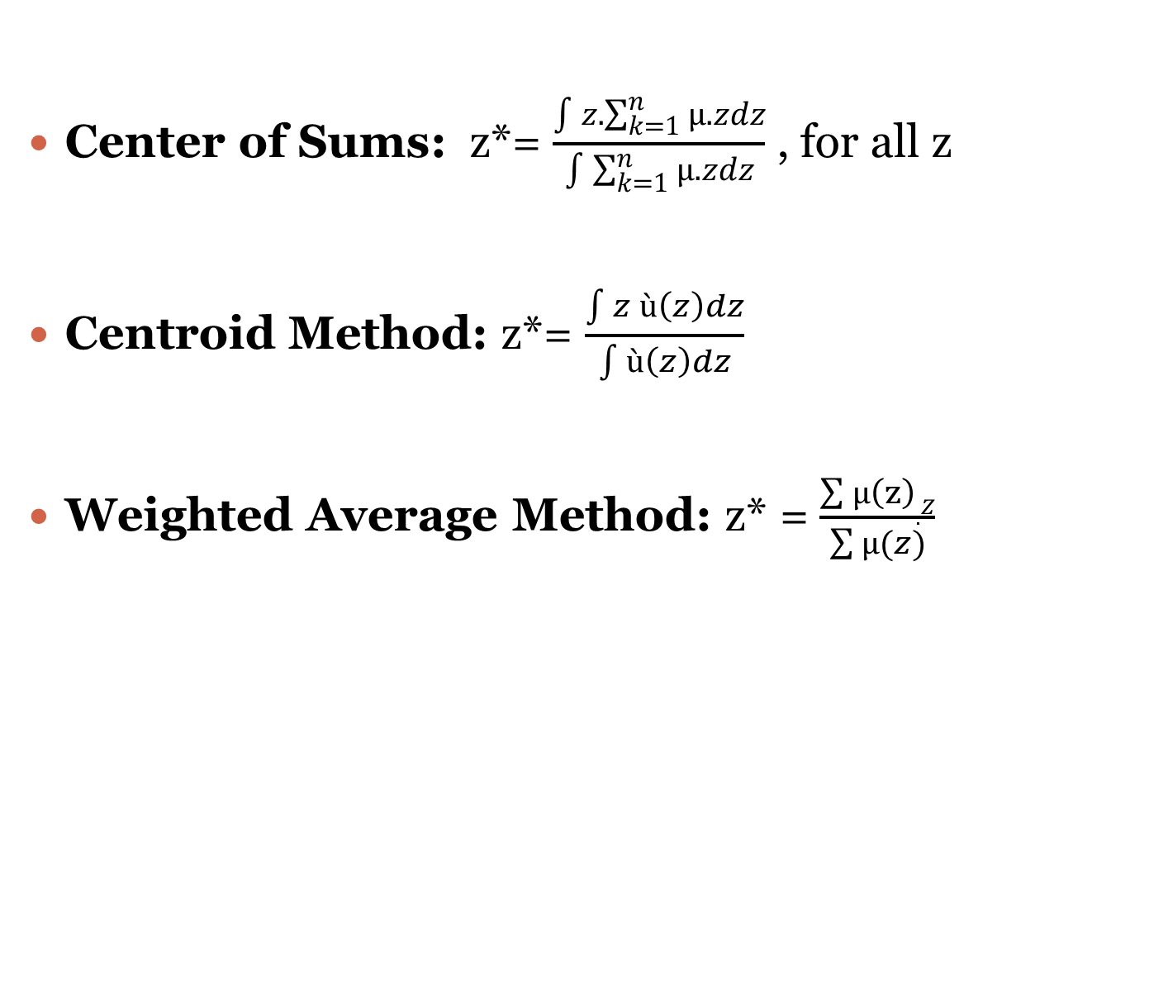
METHODS OF DEFUZZIFICATION
Center of Sums: z*= $\frac{\int{z.\sum_{k=1}^{n}{µ.zdz}}}{\int{\sum_{k=1}^{n}{µ.zdz}}}$ , for all z
Centroid Method: z*= $\frac{\int{z ù}\left(z\right)dz}{\int{ù\left(z\right)dz}}$
Weighted Average Method: z* = $\frac{\sum{µ\left(z\right).Z}}{\sum{µ(z)}}$

Slide 27
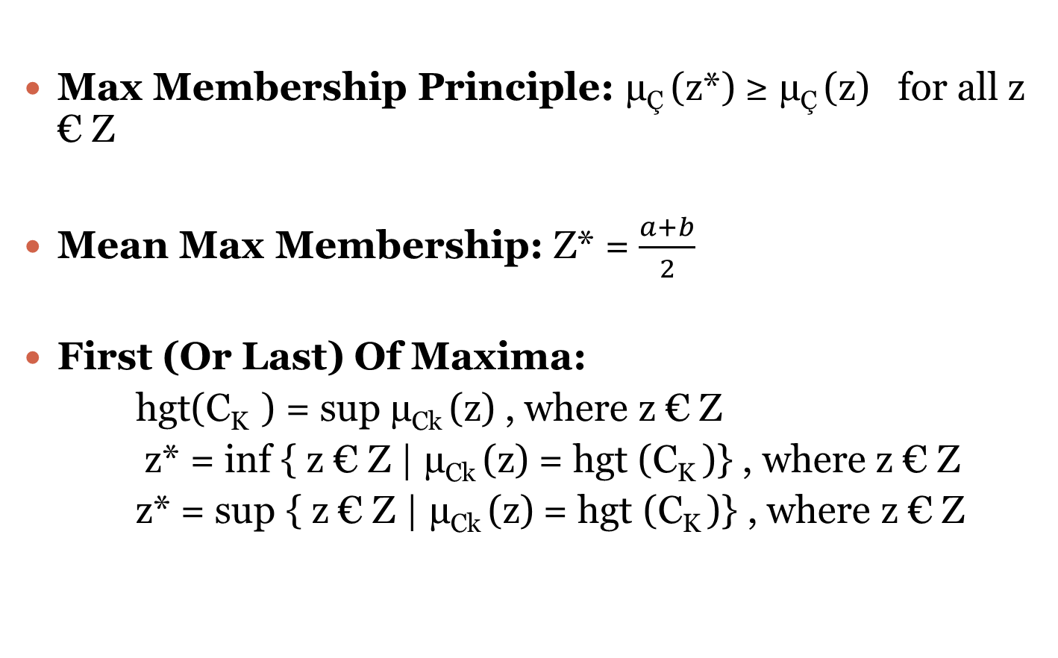
METHODS OF DEFUZZIFICATION
Max Membership Principle: µ_{Ç} (z*) ≥ µ_{Ç} (z) for all z € Z
Mean Max Membership: Z* = $\frac{a+b}{2}$
First (Or Last) Of Maxima:
hgt(C_{K} ) = sup µ_{Ck} (z) , where z € Z
z* = inf { z € Z | µ_{Ck} (z) = hgt (C_{K} )} , where z € Z
z* = sup { z € Z | µ_{Ck} (z) = hgt (C_{K} )} , where z € Z

